Slide 1

A Collection of Datasets and Simulation Frameworks for Industrial Control System Research
Dr. Thomas H. Morris
Electrical and Computer Engineering Department
University of Alabama in Huntsville
tommy.morris@uah.edu

Slide 2
Outline
System Overview + Testbeds
Attack Scripts
Datalogger
Github Repository
Current Work & Future Work
List of Testbeds
1
2
3
4
5
6
Center for Cybersecurity
Research and Education

Slide 3

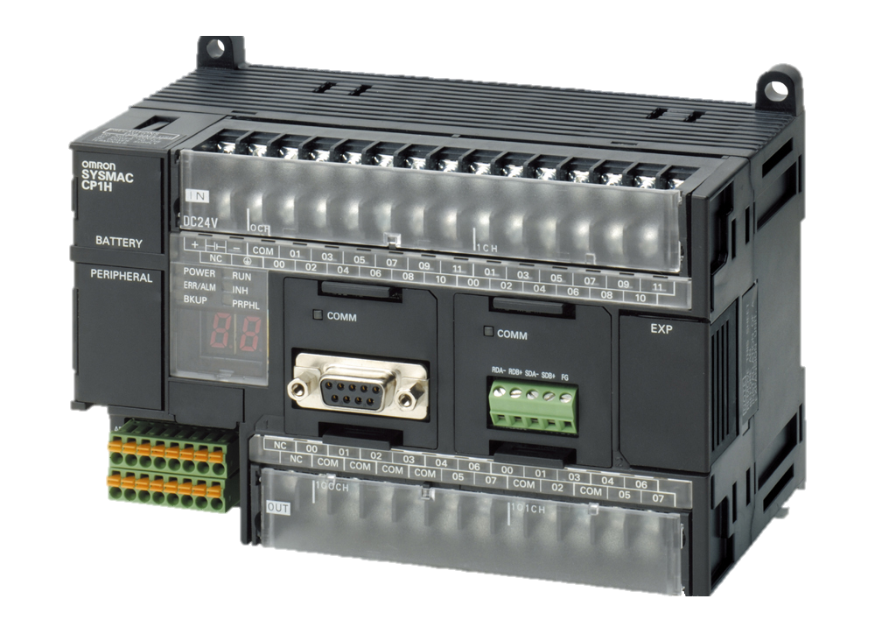
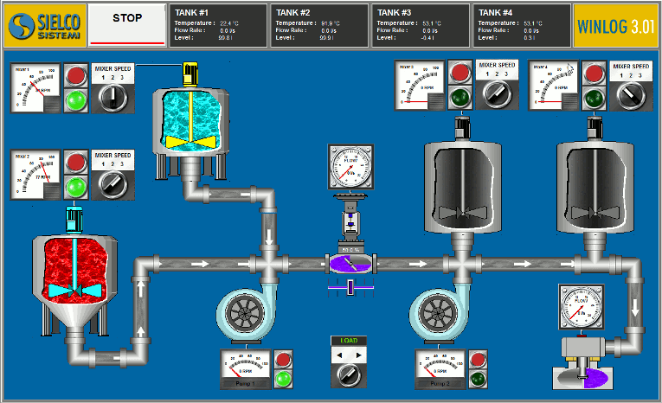




SCADA System Overview
Cyber Physical
Link
Network
DAM – Physical System
PLC
HMI
USB Cable
Network
MATLAB/ Cygwin
PLC
HMI
Center for Cybersecurity
Research and Education

Slide 4
List of Testbeds
Water Tank
Gas Pipeline
Heat Exchanger
Robot Arm
HVAC
Lock
Center for Cybersecurity
Research and Education

Slide 5

Testbed Overview
USB Cable
Network
MATLAB/ Cygwin
PLC
HMI
Network
Attacker
Center for Cybersecurity
Research and Education

Slide 6
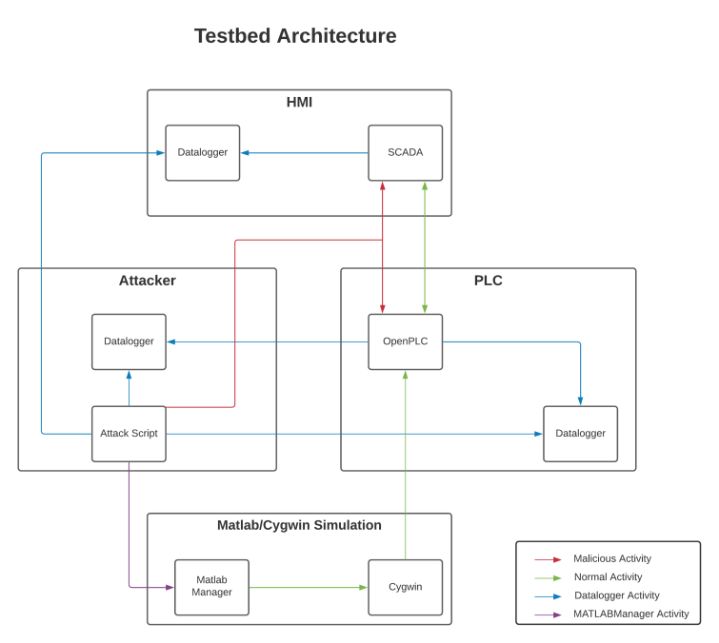
Testbed Architecture
Center for Cybersecurity
Research and Education

Slide 7
Attack Scripts
There is a base script which has many basic templates of
attacking these systems.
Each system also has its own attack script which uses its own specific registers and coils for certain attacks.
Some examples include:
- Reconnaissance
- MiTM
- DoS
- Injection
Center for Cybersecurity
Research and Education

Slide 8
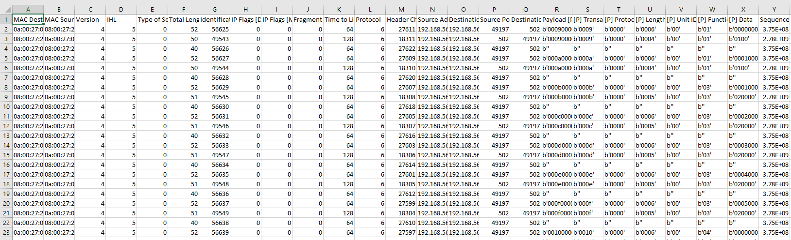
Datalogger
Records and labels network data at each node
Calculates packet info & metrics (e.g. Shannon entropy)
Assists (supervised) machine learning purposes
Binary (Normal v. Anomaly) classification that can be expanded upon
Center for Cybersecurity
Research and Education

Slide 9
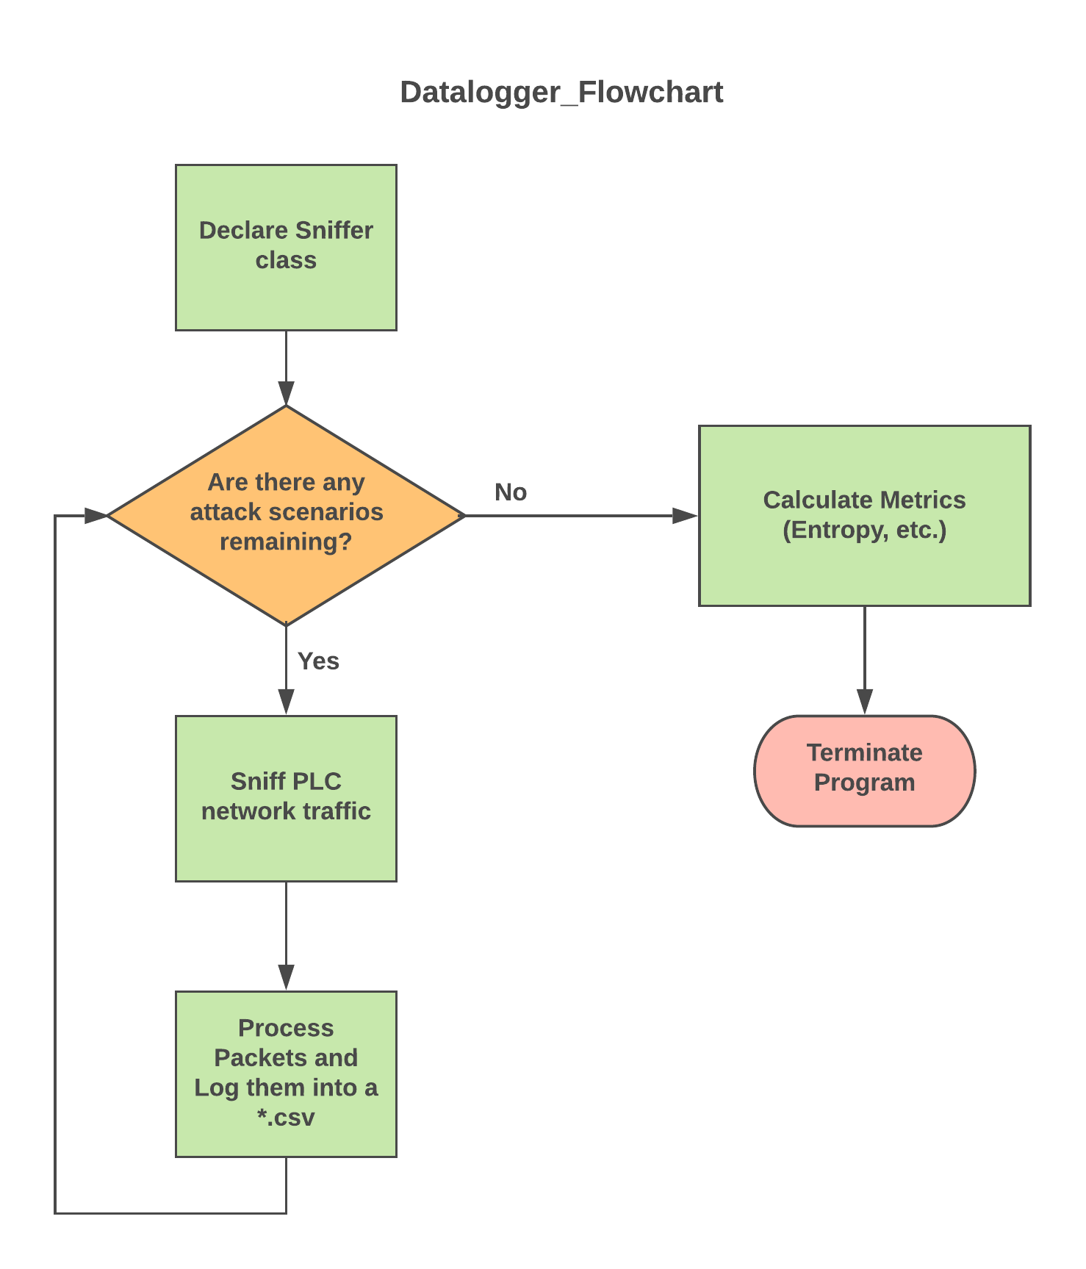
Data Log Flowchart
Center for Cybersecurity
Research and Education

Slide 10
Data Logs Instances
USB Cable
Network
MATLAB/ Cygwin
PLC
HMI
Network
Data Logs
Attacker
Center for Cybersecurity
Research and Education

Slide 11
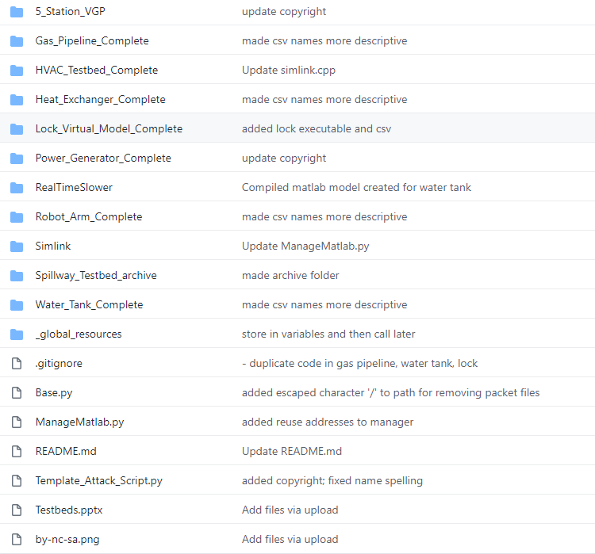
Github Repository
All systems are on Github repository for
future development
Instructions on how to get started with
setting up a system + running attack scenarios
Readme descriptions of all testbeds
https://github.com/EinaamAlim/SCADA_Testbeds_Observation
Center for Cybersecurity
Research and Education

Slide 12
Current work
Constructed SCADA testbeds for orchestrating cyberattacks against
Developed framework of conducting cyberattacks on testbeds
Recorded data logs of 1000 attack scenarios for several testbed systems
Center for Cybersecurity
Research and Education

Slide 13
Future work
With data collected, develop an intrusion detection system and/or intrusion prevention system for SCADA systems
Publish data logs as a standard for others to use when training machine learning applications in SCADA-related research
Center for Cybersecurity
Research and Education

Slide 14
List of Testbeds
Water Tank
Gas Pipeline
Heat Exchanger
Robot Arm
HVAC
Datalogger
Lock
Center for Cybersecurity
Research and Education

Slide 15
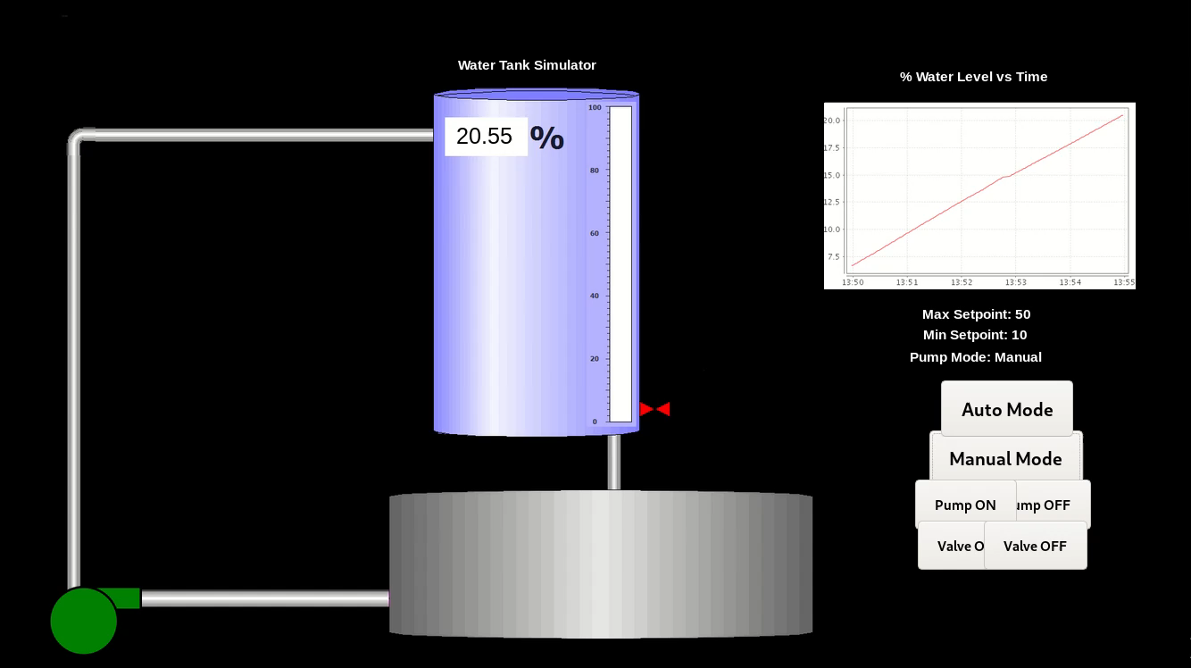
Water Tank
Center for Cybersecurity
Research and Education

Slide 16
Water Tank
Normal Operations | Time
Fill Tank - Min: 0% / Max: 25(± 3)% | 900 – 1020 sec.
Fill Tank - Min: 25(± 3)% / Max: 50(± 3)% | 900 – 1020 sec.
Fill Tank - Min: 25(± 3)% / Max: 75(± 3)% | 900 – 1020 sec.
Fill Tank - Min: 25(± 3)% / Max: 100(-3)% | 900 – 1020 sec.
Fill Tank - Min: 0% / Max: 100(-3)% | 900 – 1020 sec.
Fill Tank - Min: 0% / Max: 50(± 3)% | 900 – 1020 sec.
Fill Tank - Random setpoints | 900 – 1020 sec.
Fill Tank - Manual Mode – Pump On/Valve Off | 240 – 300 sec.
Fill Tank - Manual Mode – Pump On for a certain time -> Pump Off/Valve On | 240 – 300 sec.
Center for Cybersecurity
Research and Education

Slide 17
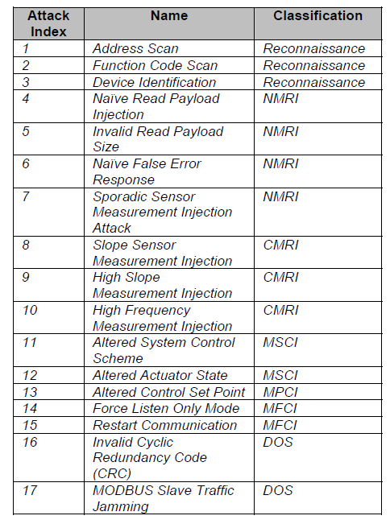
Water Tank Attacks
Attack Index – Gao’s Paper | Type of Attack - Gao's Paper | Classification - Gao's Paper | Function Name
1 | Address Scan | Reconnaissance | Reconnaissance_Address_Scan
2 | Function Code Scan | Reconnaissance | Reconnaissance_Function_Code
3 | Device identification | Reconnaissance | Reconnaissance_Device_Scan
11 | Altered System Control Scheme | Malicious State Command Injection (MSCI) | Injection_Overflow_Water_Tank
12 | Altered Actuator State | Malicious State Command Injection (MSCI) | Injection_Empty_Tank
12 | Altered Actuator State | Malicious State Command Injection (MSCI) | Injection_Water_Level_Reads
13 | Altered Control Set Point | Malicious Parameter Command Injection (MPCI) | Injection_Mode_SP_Changes
11 12 13 | Altered Actuator State / Altered System Control Scheme / Altered Control Set Point | MSCI / MPCI | Injection_Mass_Confusion
17 | MODBUS Slave Traffic Jamming | DOS | SYN_Flood_Using_Scapy
- | - | DOS | MITM_Drop_All
7/8 | Sporadic Sensor Measurement Injection/ High Frequency Measurement Injection | Response Injection | MITM_Sporadic_Sensor_Measurement
14 | Force Listen Only Mode | Malicious Function Code Injection (MFCI) | MITM_Force_Listen
15 | Restart communication | Malicious Function Code Injection (MFCI) | MITM_Restart_Modbus
5 | Invalid Read Payload Size | NMRI | MITM_Invalid_Payload_Size
4 | Naive Read Payload Size | NMRI | MITM_Naive_Read_Payload_Injection
6 | Naive False Error Response | NMRI | MITM_Exception_Code
9 | High Slope Measurement Injection | CMRI | MITM_Inject_Replayed_Sensor_Readings
8 | Calculated Sensor Measurement | CMRI | MITM_Inject_Calculated_Sensor_Readings
Center for Cybersecurity
Research and Education

Slide 18
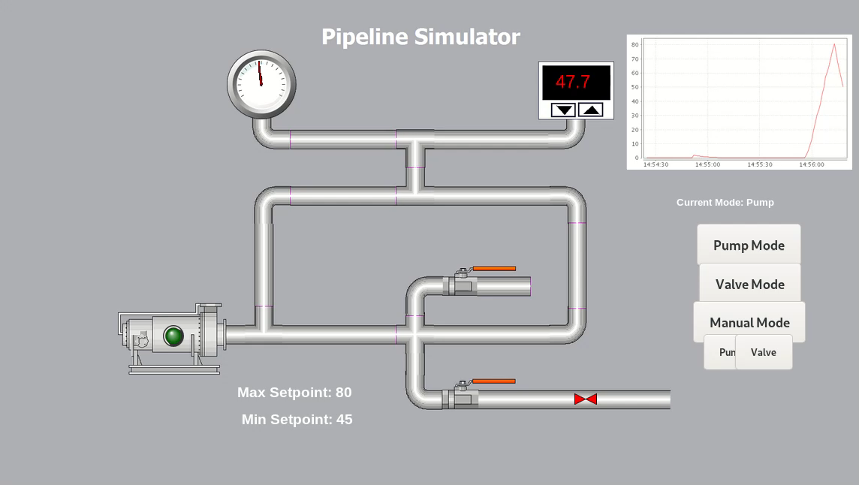
Gas Pipeline
Center for Cybersecurity
Research and Education

Slide 19
Gas Pipeline
Normal Operations | Time
Mode: automatic - Min: 35% / Max: 40% - Valve: open | 300 – 420 sec.
Mode: automatic - Min: 20% / Max: 30% - Valve: open | 300 – 420 sec.
Mode: manual - valve | 300 – 420 sec.
Mode: manual - pump | 300 – 420 sec.
Center for Cybersecurity
Research and Education

Slide 20
Gas Pipeline Attacks
Attack Index - Gao's Paper | Type of Attack - Gao's Paper | Classification - Gao's Paper | Function Name
1 | Address Scan | Reconnaissance | Reconnaissance_Address_Scan
2 | Function Code Scan | Reconnaissance | Reconnaissance_Function_Code
3 | Device identification | Reconnaissance | Reconnaissance_Device_Scan
12 | Altered Actuator State | Malicious State Command Injection (MSCI) | Injection_Pump_OnOff_30x
12 | Altered Actuator State | Malicious State Command Injection (MSCI) | Injection_Valve_OnOff_30x
12 | Altered Actuator State | Malicious State Command Injection (MSCI) | Injection_Pump_Valve_OnOff
13 | Altered Control Set Point | Malicious Parameter Command Injection (MPCI) | Injection_SP_Random
- | - | - | Injection_Random_PSI
17 | MODBUS Slave Traffic Jamming | DOS | SYN_Flood_Using_Scapy
- | - | DOS | MITM_Drop_All
7/8 | Sporadic Sensor Measurement Injection/ High Frequency Measurement Injection | Response Injection | MITM_Sporadic_Sensor_Measurement
14 | Force Listen Only Mode | Malicious Function Code Injection (MFCI) | MITM_Force_Listen
15 | Restart communication | Malicious Function Code Injection (MFCI) | MITM_Restart_Modbus
5 | Invalid Read Payload Size | NMRI | MITM_Invalid_Payload_Size
4 | Naive Read Payload Size | NMRI | MITM_Naive_Read_Payload_Injection
6 | Naive False Error Response | NMRI | MITM_Exception_Code
9 | High Slope Measurement Injection | CMRI | MITM_Inject_Replayed_Sensor_Readings
8 | Calculated Sensor Measurement | CMRI | MITM_Inject_Calculated_Sensor_Readings
Center for Cybersecurity
Research and Education

Slide 21
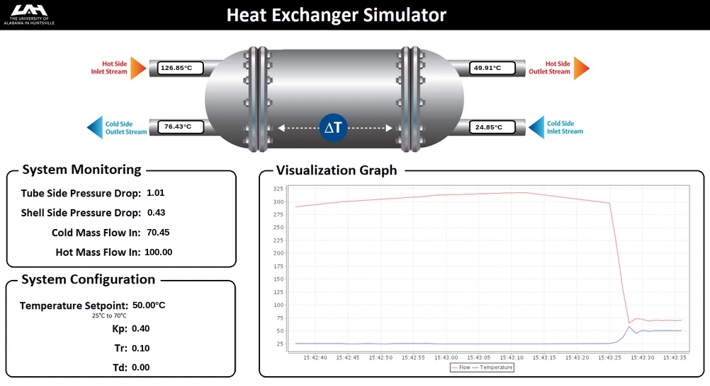
Heat Exchanger
Center for Cybersecurity
Research and Education

Slide 22
Heat Exchanger
Normal Operations | Time
Set - SP: 50 °C ; PID_td: .0 ; PID_tr: .1 ; PID_kp: .4 | 30 – 300 sec.
Set - SP: 45 °C ; PID_td: .0 ; PID_tr: .1 ; PID_kp: .4 | 30 – 300 sec.
Set - SP: 35 °C ; PID_td: .0 ; PID_tr: .1 ; PID_kp: .4 | 30 – 300 sec
Set - SP: rnd ; PID_td: .0 ; PID_tr: .1 ; PID_kp: .4 | 30 – 300 sec.
Center for Cybersecurity
Research and Education

Slide 23
Heat Exchanger Attacks
Attack Index - Gao's Paper | Type of Attack - Gao's Paper | Classification - Gao's Papaer | Function Name
1 | Address Scan | Reconnaissance | Reconnaissance_Address_Scan
2 | Function Code Scan | Reconnaissance | Reconnaissance_Function_Code
3 | Device identification | Reconnaissance | Reconnaissance_Device_Scan
8 | Slope Sensor Measurement Injection | CMRI | Injection_Increase_Hot_Temp_Slowly
8 | Slope Sensor Measurement Injection | CMRI | Injection_Decrease_Hot_Temp_Slowly
8 | Slope Sensor Measurement Injection | CMRI | Injection_Increase_Hot_Temp_Rapidly
8 | Slope Sensor Measurement Injection | CMRI | Injection_Decrease_Hot_Temp_Rapidly
11 | Altered System Control Scheme | Malicious State Command Injection (MSCI) | Injection_Set_PIDkp_To_09
11 | Altered System Control Scheme | Malicious State Command Injection (MSCI) | Injection_Set_PIDkp_To_12
11 | Altered System Control Scheme | Malicious State Command Injection (MSCI) | Injection_Set_PIDtr_To_0
11 | Altered System Control Scheme | Malicious State Command Injection (MSCI) | Injection_Set_PIDtr_To_negative
11 | Altered System Control Scheme | Malicious State Command Injection (MSCI) | Injection_Set_PIDkp_To_05
13 | Altered Control Set Point | Malicious Parameter Command Injection (MPCI) | Injection_Set_Setpoint_Below_20C
13 | Altered Control Set Point | Malicious Parameter Command Injection (MPCI) | Injection_Set_Setpoint_Above_70C
13 | Altered Control Set Point | Malicious Parameter Command Injection (MPCI) | Injection_Set_Setpoint_To_26C
13 | Altered Control Set Point | Malicious Parameter Command Injection (MPCI) | Injection_Set_Setpoint_To_0C
17 | MODBUS Slave Traffic Jamming | DOS | SYN_Flood_Using_Scapy
- | - | DOS | MITM_Drop_All
7/8 | Sporadic Sensor Measurement Injection/ High Frequency Measurement Injection | Response Injection | MITM_Sporadic_Sensor_Measurement
14 | Force Listen Only Mode | Malicious Function Code Injection (MFCI) | MITM_Force_Listen
15 | Restart communication | Malicious Function Code Injection (MFCI) | MITM_Restart_Modbus
5 | Invalid Read Payload Size | NMRI | MITM_Invalid_Payload_Size
4 | Naive Read Payload Size | NMRI | MITM_Naive_Read_Payload_Injection
6 | Naive False Error Response | NMRI | MITM_Exception_Code
9 | High Slope Measurement Injection | CMRI | MITM_Inject_Replayed_Sensor_Readings
8 | Calculated Sensor Measurement | CMRI | MITM_Inject_Calculated_Sensor_Readings
Center for Cybersecurity
Research and Education

Slide 24
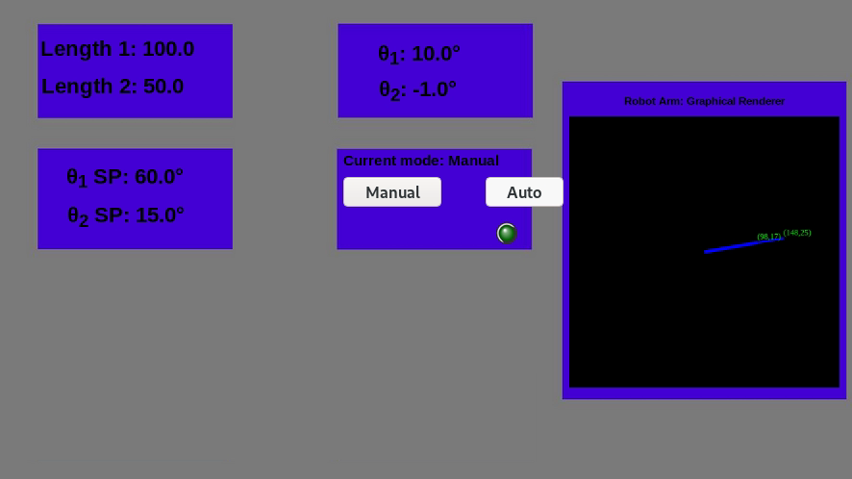
Robot Arm
Center for Cybersecurity
Research and Education

Slide 25
Robot Arm
Normal Operations | Time
Normal Operation Manual – set valid values for SP and lengths | 30 – 120 sec.
Normal Operation Auto – configures the arm to perform a random number of cycles btween two sets of randomly chosen valid angle SP | 300 – 600 sec.
Center for Cybersecurity
Research and Education

Slide 26
Robot Arm Attacks
Attack Index - Gao's Paper | Type of Attack - Gao's Paper | Classification - Gao's Papaer | Function Name
1 | Address Scan | Reconnaissance | Reconnaissance_Address_Scan
2 | Function Code Scan | Reconnaissance | Reconnaissance_Function_Code
3 | Device identification | Reconnaissance | Reconnaissance_Device_Scan
11 | Altered System Control Scheme | Malicious State Command Injection (MSCI) | Injection_Altered_Manual_Control_SP
11 | Altered System Control Scheme | Malicious State Command Injection (MSCI) | Injection_Altered_Auto_Control_SP
17 | MODBUS Slave Traffic Jamming | DOS | SYN_Flood_Using_Scapy
- | - | DOS | MITM_Drop_All
7/8 | Sporadic Sensor Measurement Injection/ High Frequency Measurement Injection | Response Injection | MITM_Sporadic_Sensor_Measurement
14 | Force Listen Only Mode | Malicious Function Code Injection (MFCI) | MITM_Force_Listen
15 | Restart communication | Malicious Function Code Injection (MFCI) | MITM_Restart_Modbus
5 | Invalid Read Payload Size | NMRI | MITM_Invalid_Payload_Size
4 | Naive Read Payload Size | NMRI | MITM_Naive_Read_Payload_Injection
6 | Naive False Error Response | NMRI | MITM_Exception_Code
9 | High Slope Measurement Injection | CMRI | MITM_Inject_Replayed_Sensor_Readings
8 | Calculated Sensor Measurement | CMRI | MITM_Inject_Calculated_Sensor_Readings
Center for Cybersecurity
Research and Education

Slide 27
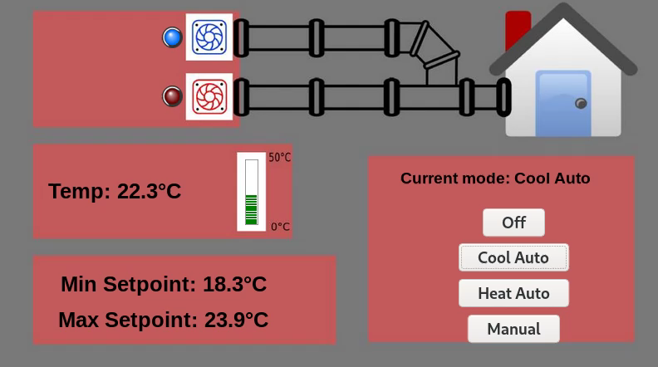
HVAC
Center for Cybersecurity
Research and Education

Slide 28
HVAC
Normal Operations | Time
Heat => Mode: auto – Min: 20(± 3)°C / Max: 23(± 3)°C | 300 – 420 sec.
Cool => Mode: auto – Min: 20(± 3)°C / Max 23(± 3)°C | 300 – 420 sec.
Randomly chosen auto mode: Min 18(± 3)°- 23(± 3)°C Max: Min(± 3)-23(± 3)°C | 300 – 420 sec.
Center for Cybersecurity
Research and Education

Slide 29
HVAC Attacks
Attack Index - Gao's Paper | Type of Attack - Gao's Paper | Classification - Gao's Papaer | Function Name
1 | Address Scan | Reconnaissance | Reconnaissance_Address_Scan
2 | Function Code Scan | Reconnaissance | Reconnaissance_Function_Code
3 | Device identification | Reconnaissance | Reconnaissance_Device_Scan
3 | Device identification | Reconnaissance | Reconnaissance_Device_Scan
11 | Altered System Control Scheme | Malicious State Command Injection (MSCI) | Injection_Shutdown
13 | Altered Control Set Point | Malicious Parameter Command Injection (MPCI) | Injection_SP_Random
- | - | - | Injection_Random_Temp
- | - | - | Injection_Simultaneous_Heating_Cooling
11 12 13 | Altered Actuator State / Altered System Control Scheme / Altered Control Set Point | MSCI / MPCI | Injection_Overcool
11 12 13 | Altered Actuator State / Altered System Control Scheme / Altered Control Set Point | MSCI / MPCI | Injection_Overheat
17 | MODBUS Slave Traffic Jamming | DOS | SYN_Flood_Using_Scapy
- | - | DOS | MITM_Drop_All
7/8 | Sporadic Sensor Measurement Injection/ High Frequency Measurement Injection | Response Injection | MITM_Sporadic_Sensor_Measurement
14 | Force Listen Only Mode | Malicious Function Code Injection (MFCI) | MITM_Force_Listen
15 | Restart communication | Malicious Function Code Injection (MFCI) | MITM_Restart_Modbus
5 | Invalid Read Payload Size | NMRI | MITM_Invalid_Payload_Size
4 | Naive Read Payload Size | NMRI | MITM_Naive_Read_Payload_Injection
6 | Naive False Error Response | NMRI | MITM_Exception_Code
9 | High Slope Measurement Injection | CMRI | MITM_Inject_Replayed_Sensor_Readings
8 | Calculated Sensor Measurement | CMRI | MITM_Inject_Calculated_Sensor_Readings
Center for Cybersecurity
Research and Education

Slide 30
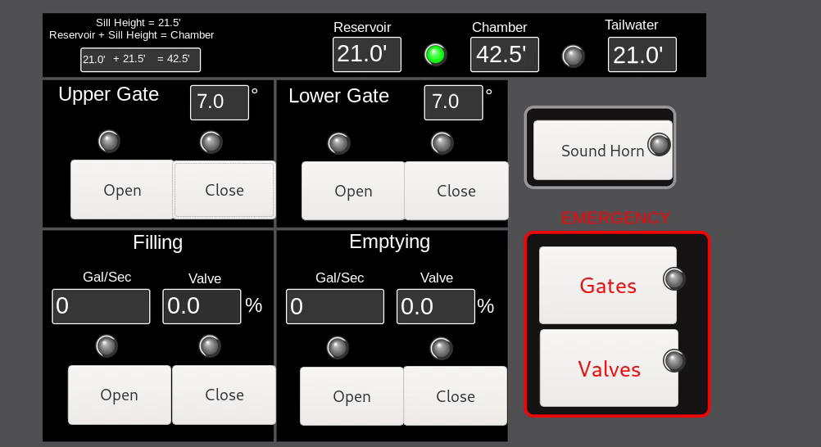
Lock
Center for Cybersecurity
Research and Education

Slide 31
Lock
Normal Operations | Time
Boat headed downstream | -
Boat headed upstream | -
No boat in lock | -
Center for Cybersecurity
Research and Education

Slide 32
Lock Attacks
Attack Index - Gao's Paper | Type of Attack - Gao's Paper | Classification - Gao's Papaer | Function Name
1 | Address Scan | Reconnaissance | Reconnaissance_Address_Scan
2 | Function Code Scan | Reconnaissance | Reconnaissance_Function_Code
3 | Device identification | Reconnaissance | Reconnaissance_Device_Scan
3 | Device identification | Reconnaissance | Reconnaissance_Device_Scan
11 | Altered Actuator State | Malicious State Command Injection (MSCI) | Injection: suspend upper gate
11 | Altered Actuator State | Malicious State Command Injection (MSCI) | Injection: suspend lower gate
11 | Altered Actuator State | Malicious State Command Injection (MSCI) | Injection: close gate on boat
11 | Altered Actuator State | Malicious State Command Injection (MSCI) | Injection: suspend water level
17 | MODBUS Slave Traffic Jamming | DOS | SYN_Flood_Using_Scapy
- | - | DOS | MITM_Drop_All
7/8 | Sporadic Sensor Measurement Injection/ High Frequency Measurement Injection | Response Injection | MITM_Sporadic_Sensor_Measurement
14 | Force Listen Only Mode | Malicious Function Code Injection (MFCI) | MITM_Force_Listen
15 | Restart communication | Malicious Function Code Injection (MFCI) | MITM_Restart_Modbus
5 | Invalid Read Payload Size | NMRI | MITM_Invalid_Payload_Size
4 | Naive Read Payload Size | NMRI | MITM_Naive_Read_Payload_Injection
6 | Naive False Error Response | NMRI | MITM_Exception_Code
9 | High Slope Measurement Injection | CMRI | MITM_Inject_Replayed_Sensor_Readings
8 | Calculated Sensor Measurement | CMRI | MITM_Inject_Calculated_Sensor_Readings
Center for Cybersecurity
Research and Education

